Slide 1

Note from SME:
Screen 1:
Note to Developer:
Continue to next screen
What’s a good idea?
START
Notes:
Audio:
Welcome to the course on What’s a good idea? This course is designed for all employees to enable them to understand essence of a good idea, have an overview of the overall Idea Management Process in the company and update them on Do’s & Don’ts while submitting an idea in Idea Junction Portal

Slide 2
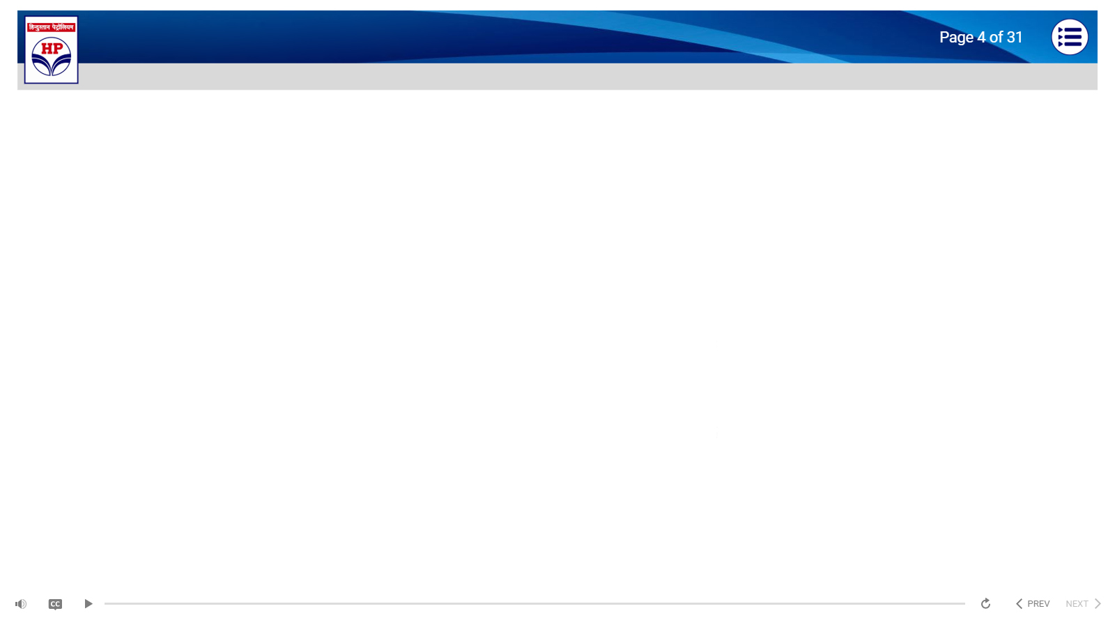
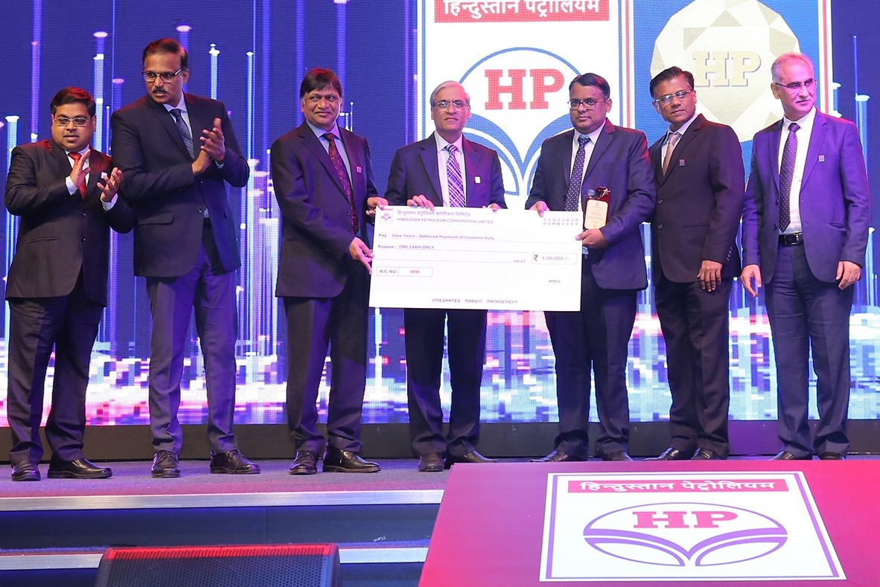



Note from SME:
Screen 1a:
Note to Developer:
Continued from previous screen.
Provide a start button to navigate to next screen
What’s a good idea?
The course would take around 30 minutes to complete. Do feel free to pause as often as required.
You can use the Table of Contents or the Back button to navigate to any of the previously covered topics within this course.
There are Knowledge Check questions after every module. You can try them as many times as you like.
The course is followed by an assessment. You are expected to score at least 70% in order to get credit.
In the event you do not score 70%, you will be required to go through the course again in order to retake the assessment.
Notes:
Audio:
Please read the following pointers carefully.

Slide 3

Note from SME:
Screen 2:
Note to Developer:
Sync text and audio
https://www.shutterstock.com/image-vector/good-idea-concept-vector-illustration-isolated-253653196
What’s a good idea?
Objectives
At the end of this course, you will be able to:
Understand the importance of a good idea
Comprehend idea management process
Know the process flow of ideas from generation to implementation
Understand stage wise Recognition and Rewards system
Clearly know how to submit an idea in the Idea Junction Portal
Notes:
Audio:
At the end of this course, you will be able to:
Understand the importance of a good idea
Comprehend idea management process
Know the process flow of ideas from generation to implementation
Understand stage wise Recognition and Rewards system
Clearly know how to submit an idea in the Idea Junction Portal

Slide 4



Note from SME:
Screen 3:
Note to Developer:
Provide a start button to navigate to next screen
Keep this as a linear progression
Shutterstock Id: https://www.shutterstock.com/image-photo/bulb-light-on-women-fingertip-blue-92821549
What’s a good idea?
This course is divided into two modules:
Good idea Vs.
Not-so-good idea
Idea Management Process
Click on module name to start.
Notes:
Audio:
For ease of understanding, we have divided this course into two modules. Please click on each module to Start.

Slide 5

Note from SME:
Screen 5:
Note to Developer:\
https://www.shutterstock.com/image-photo/wooden-figures-people-rivals-business-stand-1190343568
What’s a good idea?
Module 1
Good Idea Vs. Not-so-good Idea
Notes:
Audio:

Slide 6


Note from SME:
Screen 4d:
Note to Developer:
Use animation for screen
https://www.shutterstock.com/image-photo/creative-idea-new-innovation-solution-concepts-772892509
What’s a good idea?
Idea Junction Portal
Idea Junction Portal has been developed to collect ideas from employees across the organization
Idea Junction within IMM (Integrated Margin Management) is a single point comprehensive platform for idea management system across the various SBUs/ Functions in the corporation
To facilitate seamless idea evaluation process, leading finally to implementation and monitoring of benefit
Notes:
Audio:
In order to support the idea generation and idea management, an Idea Junction Portal has been developed for the submission source of ideas from employees across the organization and also to facilitate seamless idea evaluation process, leading finally to implementation and monitoring of benefit.
Idea Junction within IMM (Integrated Margin Management) is a single point comprehensive corporate platform for idea management system across the various SBUs/ Functions in the corporation.

Slide 7
Note from SME:
Screen 7:
Use assessment template.
This is multiple choice question with 1 correct answer.
Give one attempt to the learner.
Correct answer highlighted in green colour
Feedback:
For correct answer: Well Done!
For incorrect answer: You missed it! The correct answer is selected for you.
What’s a good idea?
Knowledge Check 1
Which of the following is a characteristic of a good idea?
Select the correct option and then select Submit.
No clarity on benefits envisaged
Generic Ideas like use of EVs / Solar
Clearly delivers a value
No clarity on benefits envisaged
Submit
Notes:
Audio:
No need of audio. Feedback will be shown on screen

Slide 8
Note from SME:
Screen 8:
Use assessment template.
This is multiple choice question with 1 correct answer.
Give one attempt to the learner.
Correct answer highlighted in green
Feedback:
For correct answer: Well Done!
For incorrect answer: You missed it! The correct answer is selected for you.
What’s a good idea?
Knowledge Check 2
Which of the following is an example of tangible idea?
Select the correct option and then select Submit.
Integration of PA & VHF System
Weight Optimization of HDPE lube containers
E-Panchanama for ROU acquisition activities
Hiring of 3rd Party for PESO License approval
Submit
Notes:
Audio:
No need of audio. Feedback will be shown on screen

Slide 9

Note from SME:
Screen 9:
Note to Developer:\
https://www.shutterstock.com/image-photo/wooden-figures-people-rivals-business-stand-1190343568
What’s a good idea?
Module 2
Idea Management Process
Notes:
Audio:

Slide 10
Note from SME:
Screen 14a:
Note to Developer:
Tab interactivity
What’s a good idea?
Idea Funnel
IL1
IL2
IL3
IL4
IL5
Click on each part of funnel to learn more
Notes:
Audio:
Now we will understand the concept of idea funnel. Click on each part of funnel to learn more.

Slide 11
Note from SME:
Screen 14b
Note to Developer:
Continued from previous screen.
What’s a good idea?
Idea Funnel
Idea
IL1
IL1
IL2
Idea submitted in portal with savings roughly quantified
IL3
IL4
IL5
Click on each part of funnel to learn more
Notes:
Audio:
In IL 1 stage, Idea submitted in portal with savings roughly quantified

Slide 12
Note from SME:
Screen 14c
Note to Developer:
Continued from previous screen.
What’s a good idea?
Idea Funnel
Idea
IL2
IL1
Initial feasibility confirmed by Idea evaluation committee with inputs from broader stakeholders incorporated
IL2
IL3
IL4
IL5
Click on each part of funnel to learn more
Notes:
Audio:
In IL2 stage, initial feasibility confirmed by Idea evaluation committee with inputs from broader stakeholders incorporated

Slide 13
Note from SME:
Screen 14c
Note to Developer:
Continued from previous screen.
What’s a good idea?
Idea Funnel
Idea
IL3
IL1
Detailed implementation plan developed and Signed off jointly by BU/Function Head IMM Head
IL2
IL3
IL4
IL5
Click on each part of funnel to learn more
Notes:
Audio:
In IL3 stage, detailed implementation plan developed and Signed off jointly by BU/Function Head and IMM Head

Slide 14
Note from SME:
Screen 14d:
Note to Developer:
Continued from previous screen.
What’s a good idea?
Idea Funnel
Idea
IL4
IL1
Implementation plan put into effect and performance management system active to track Idea implementation
IL2
IL3
IL4
IL5
Click on each part of funnel to learn more
Notes:
Audio:
In IL4 stage, implementation plan put into effect and performance management system active to track Idea implementation

Slide 15
Note from SME:
Screen 14e:
Note to Developer:
Continued from previous screen.
What’s a good idea?
Idea Funnel
Idea
IL5
IL1
Bottom line value realized and confirmed by finance/commercial functionary
Benefits being tracked for 18 months
IL2
IL3
IL4
IL5
Click on each part of funnel to learn more
Notes:
Audio:
In IL5 stage, bottom line value realized and confirmed by finance. Benefits being tracked for 18 months

